Slide 1
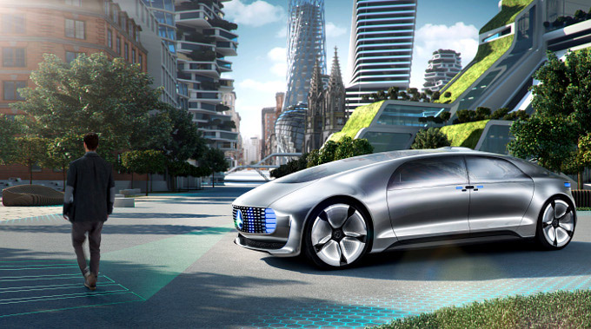
Modeling Interactions Between Pedestrians and Autonomous Vehicles
Salma Benslimane
Dan Xu
Mubarak Abdul Kader
Moyu Li
Dayi Wang
April, 2018
Notes:
Story methodology - With all the expectations around Autonomous Vehicles, people expect their lives to get better and more importantly, safer. My good friend Paul who works in a major automaker’s R&D division, he dreams of a similar safer world. But every time we discuss this, he’s worried about one thing. What happens when the AV is faced with a trolley problem? Why would anyone welcome an era of vehicles that are explicitly designed to sacrifice its own passenger? Our project was inspired by this exact problem statement and our approach is to focus on one major aspect that can reduce the probability of a trolley problem occurring - interactions with jaywalkers.

Slide 2
The market for Autonomous Vehicles is growing at an increasing rate
12
Million
$42-$77
Billion
25%
Autonomous vehicles sold per year by 2035
Growth in the market for autonomous vehicle (2025-2035)
Market share of new car market
Source: Infoholic Research LLP. (2017). Autonomous Vehicle Market: Global Drivers, Restraints, Opportunities, Trends, and Forecasts to 2023. Research and Markets.
Notes:
Moyu

Slide 3


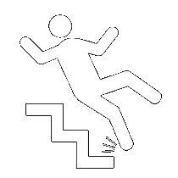
Entry into market is not without challenges
Touch path ahead!
Decision-making Dilemma
1
Ethical
Algorithm to provide human intuition
Artificial Intelligence
2
Technical
Hardware
Autonomous Vehicles
| Challenges |
Liability Issues
3
Regulatory
Policy and Safety Standard
Source: Daniel J.Fagnanta, Kara Kockelmanb(2015). Preparing a nation for autonomous vehicles: opportunities, barriers and policy recommendations. Transportation Research Part A: Policy and Practice, 167-181
Notes:
Moyu

Slide 4
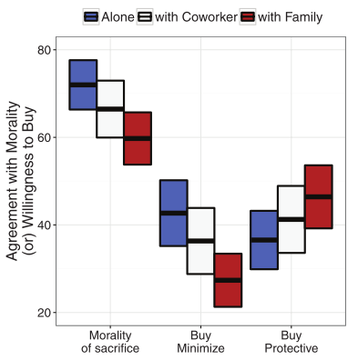
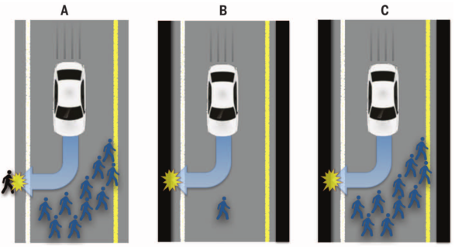
AV Ethics Paradox - Consumers have conflicting needs
Source: Jean-François Bonnefon, Azim Shariff, and Iyad Rahwan (2016). The Social Dilemma of autonomous vehicles. Science, 252(62593), 1573-6. doi:10.1126/science.aaf2654
Notes:
Salma = 1 to 4

Slide 5



Our algorithm’s performance depends on the following phases
Data Collection
Trajectory Extraction
Feature Engineering & Model Building
Logistic Regression & Random Forest
Data is collected as videos of vehicles interacting with jaywalkers
OpenCV (Open Source Computer Vision) is used to track moving objects and extract trajectories frame by frame
New and relevant features are created from the trajectory data to train a logistic regression model
Two machine learning models are tested: logistic regression model and random forest model
Notes:
Salma

Slide 6
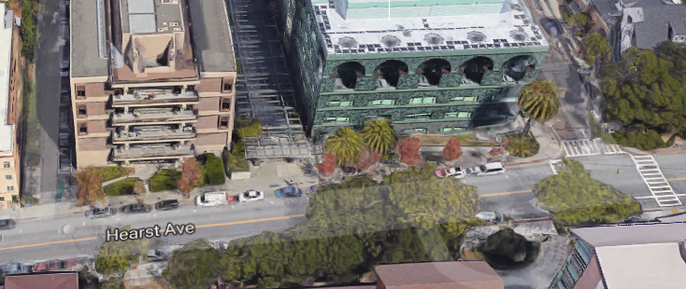
Camera captures interactions between vehicles and pedestrian

Slide 7
Traffic Intelligence code is more suitable than the PATH code
PATH
TI
Provided by our sponsor
Open Source, Traffic Intelligence
Only works for vehicles
Needs to create new database based on the output
Works for vehicles and pedestrians
Assemble all output into database
Notes:
Dayi

Slide 8
Traffic Intelligence code provides detailed trajectories for modeling
Detection
Tracking
Database
Classification
Source: Bradski, G., and A. Kaehler. Learning Opencv: Computer Vision with the OpenCV Library. 2008. & Saunier, N., and T. Sayed. A Feature-Based Tracking Algorithm for Vehicles in Intersections. 2006.
Notes:
The Kanade–Lucas–Tomasi feature tracking algorithm is a method of feature extraction in computer vision and it uses spatial intensity information to direct the search for the position that has the best match.
Dayi

Slide 9
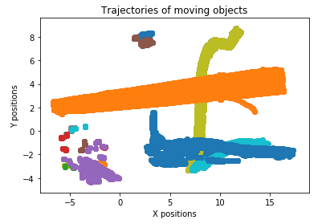
Traffic Intelligence code works!
Notes:
Dayi

Slide 10
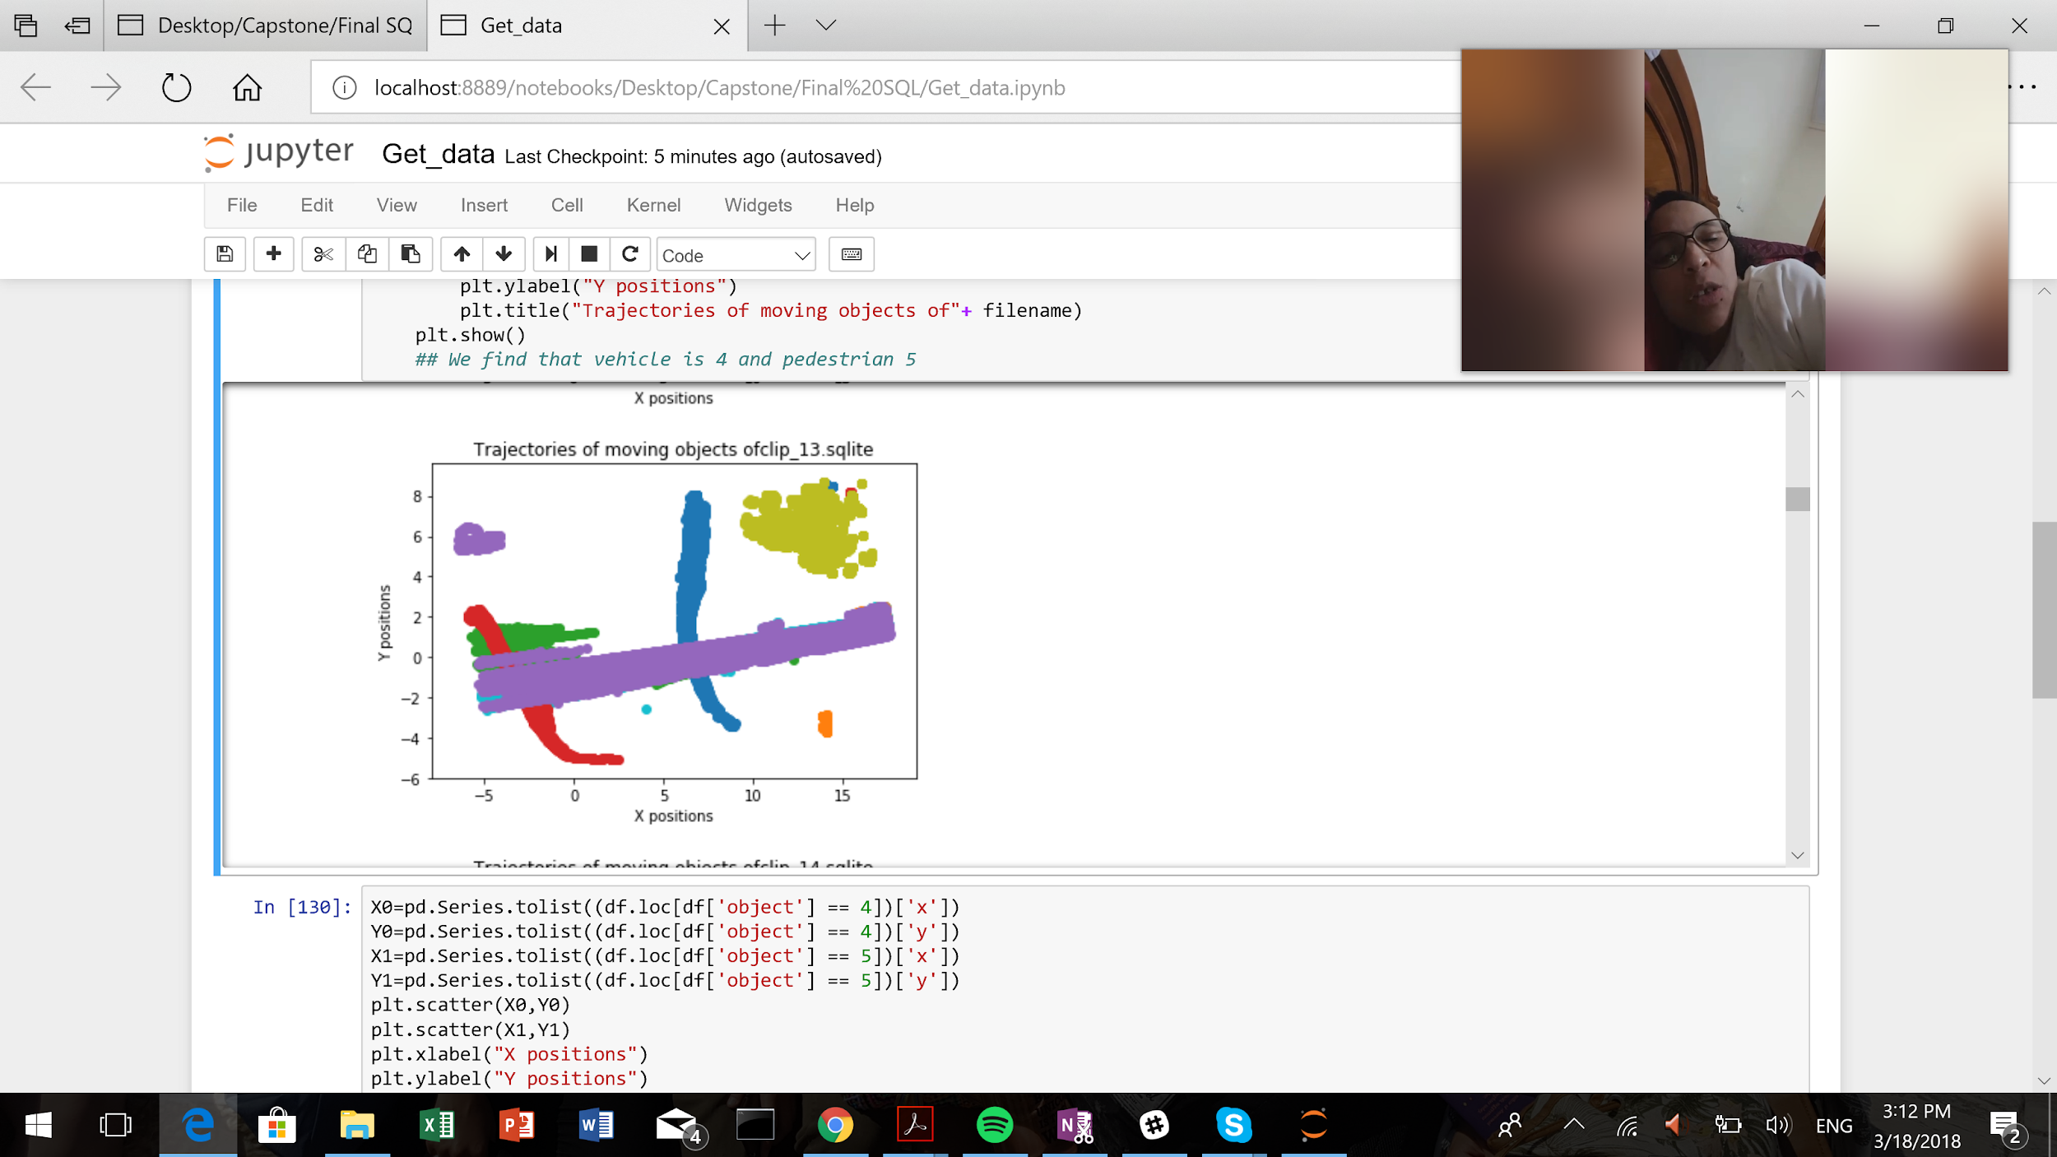
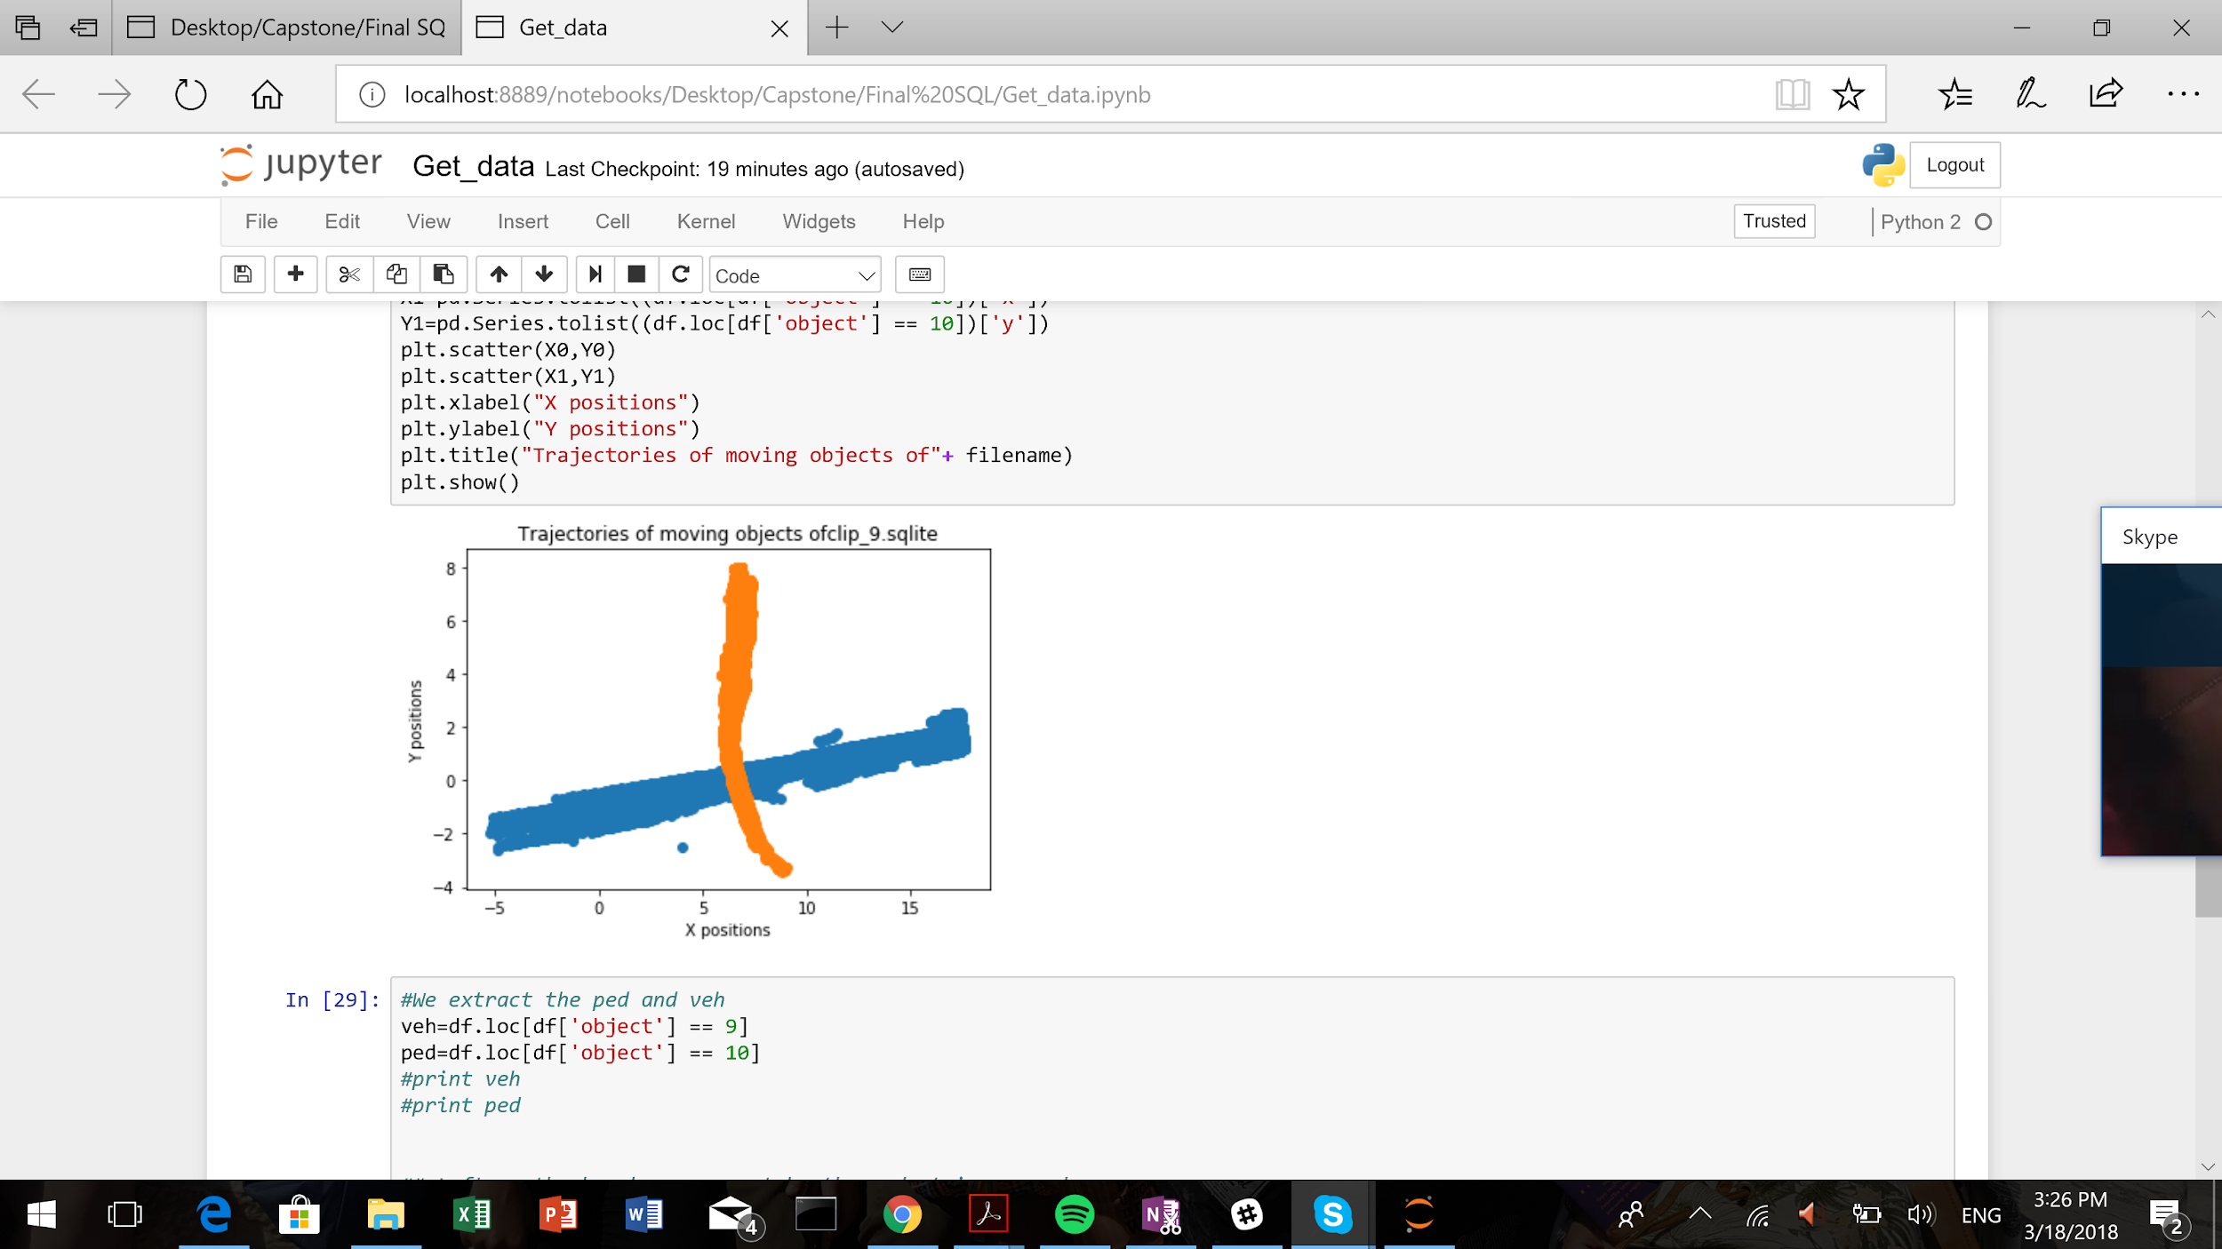
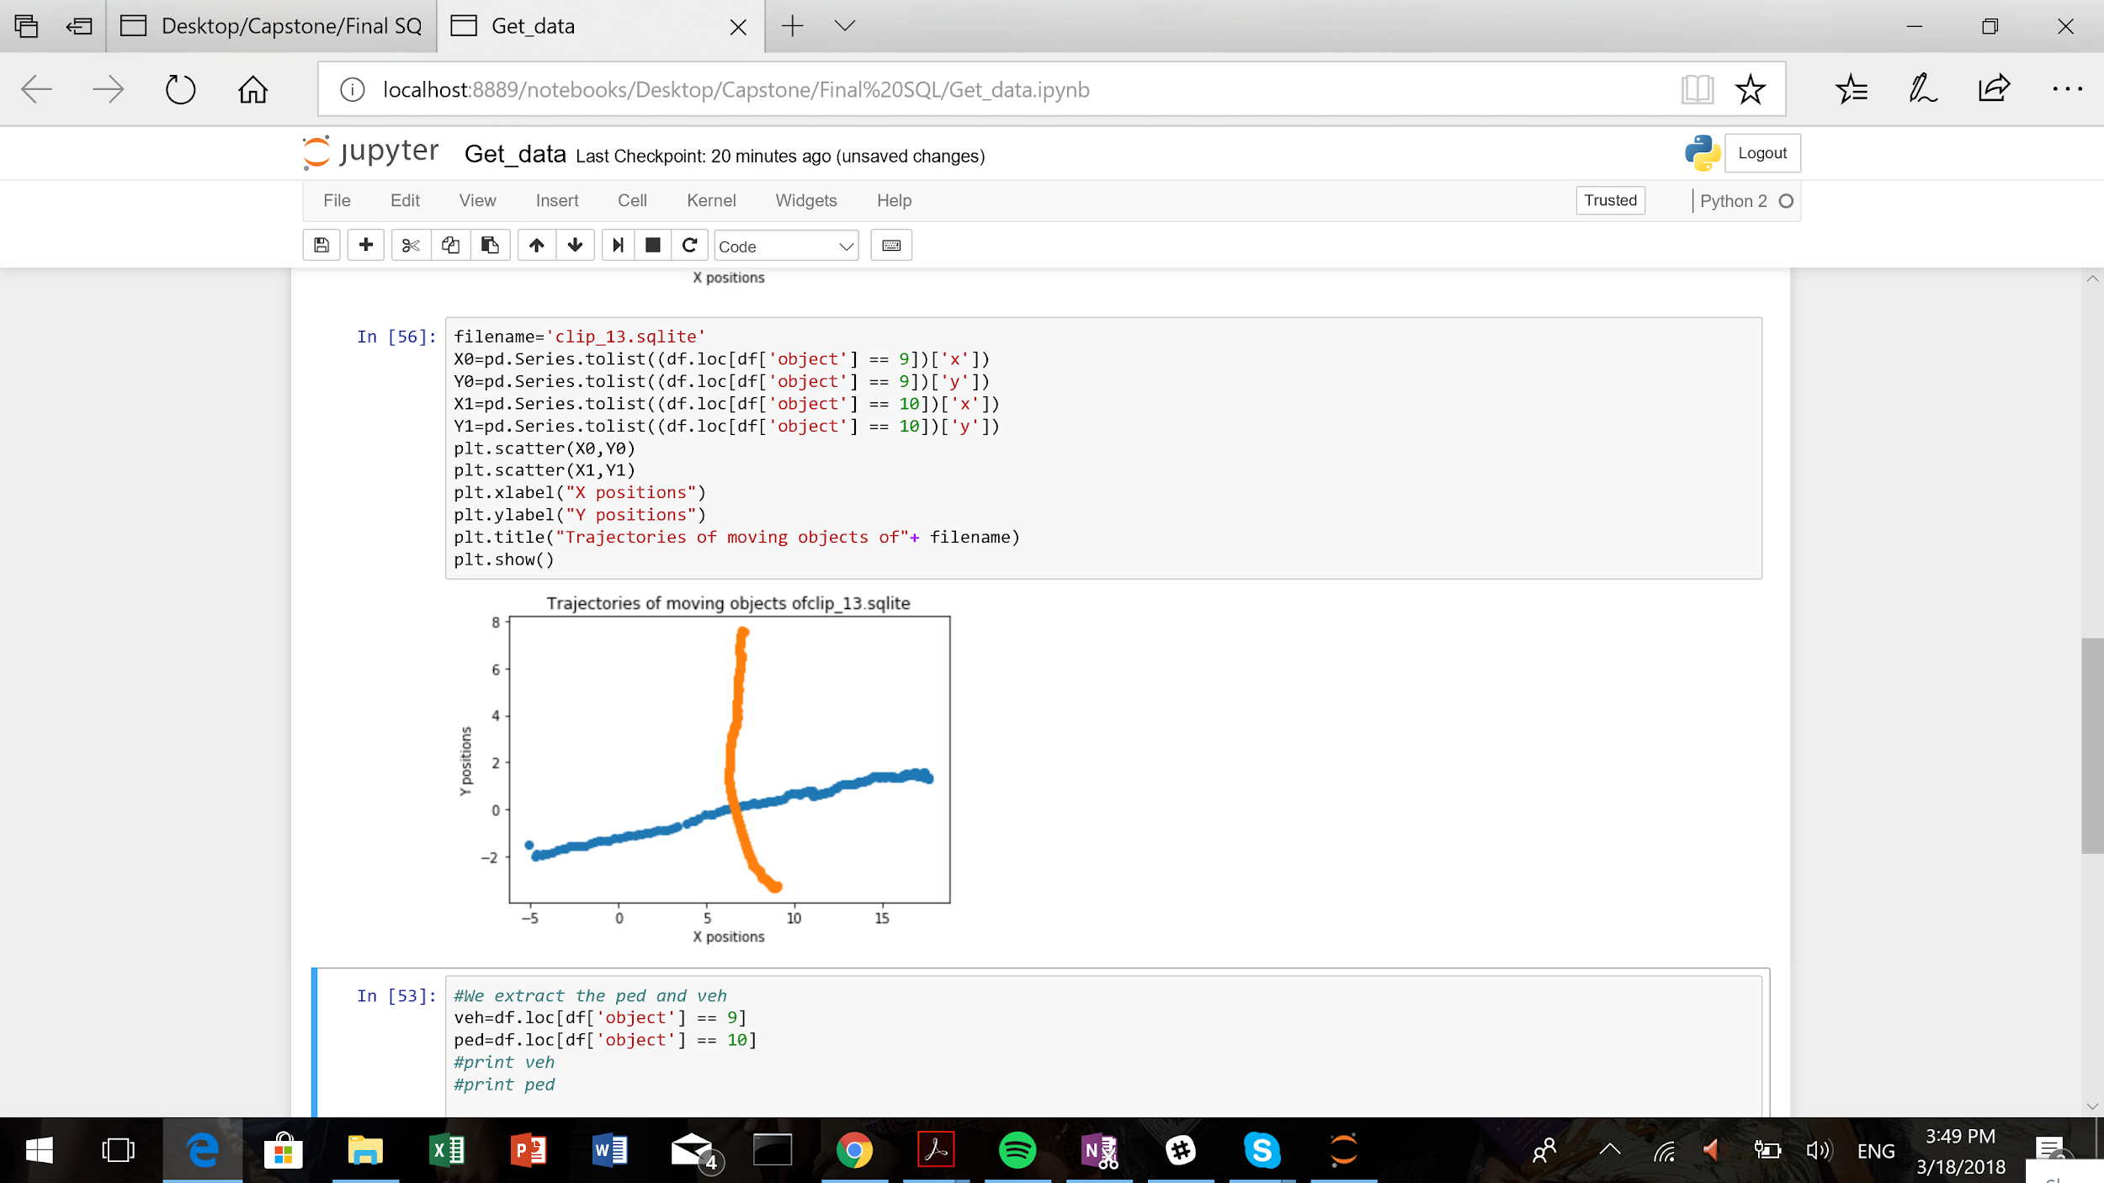
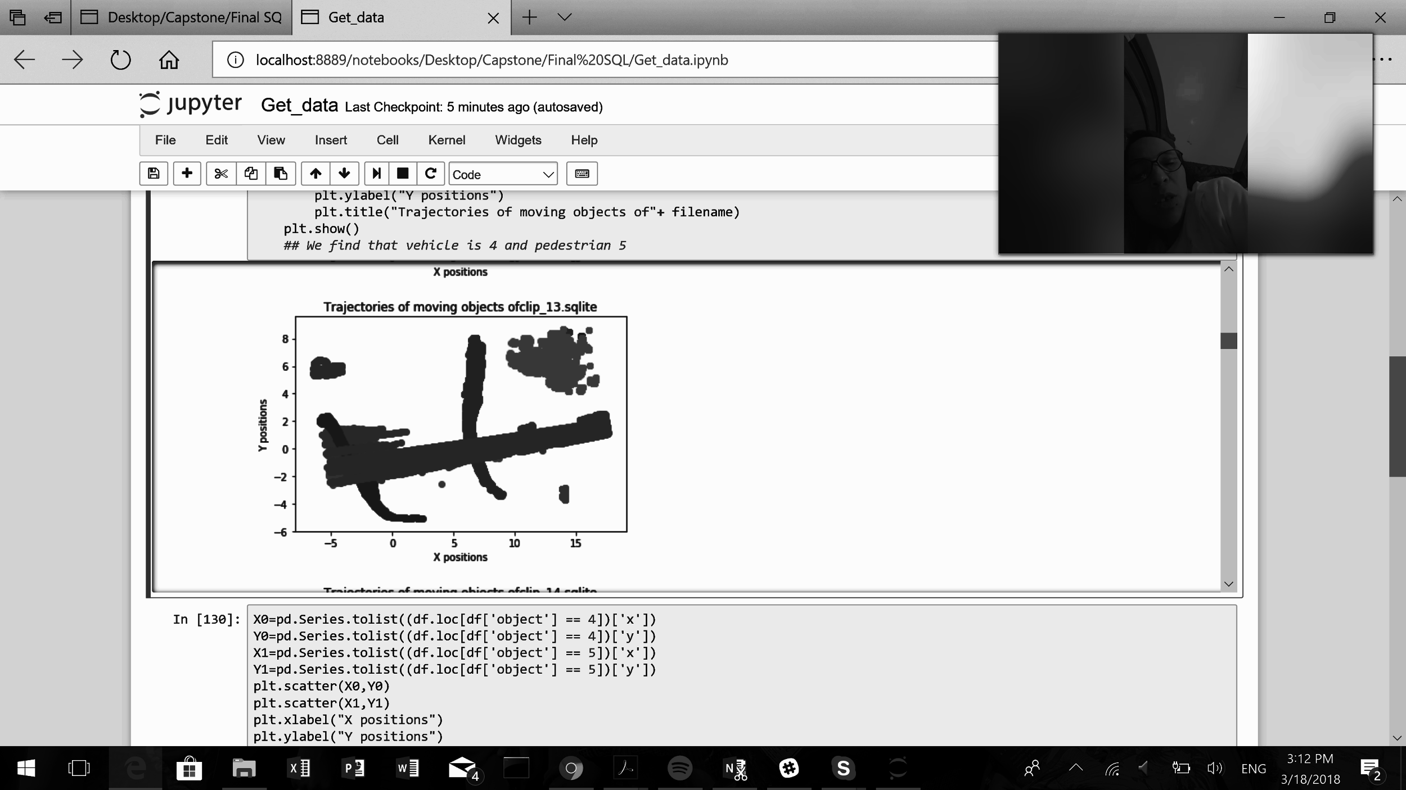
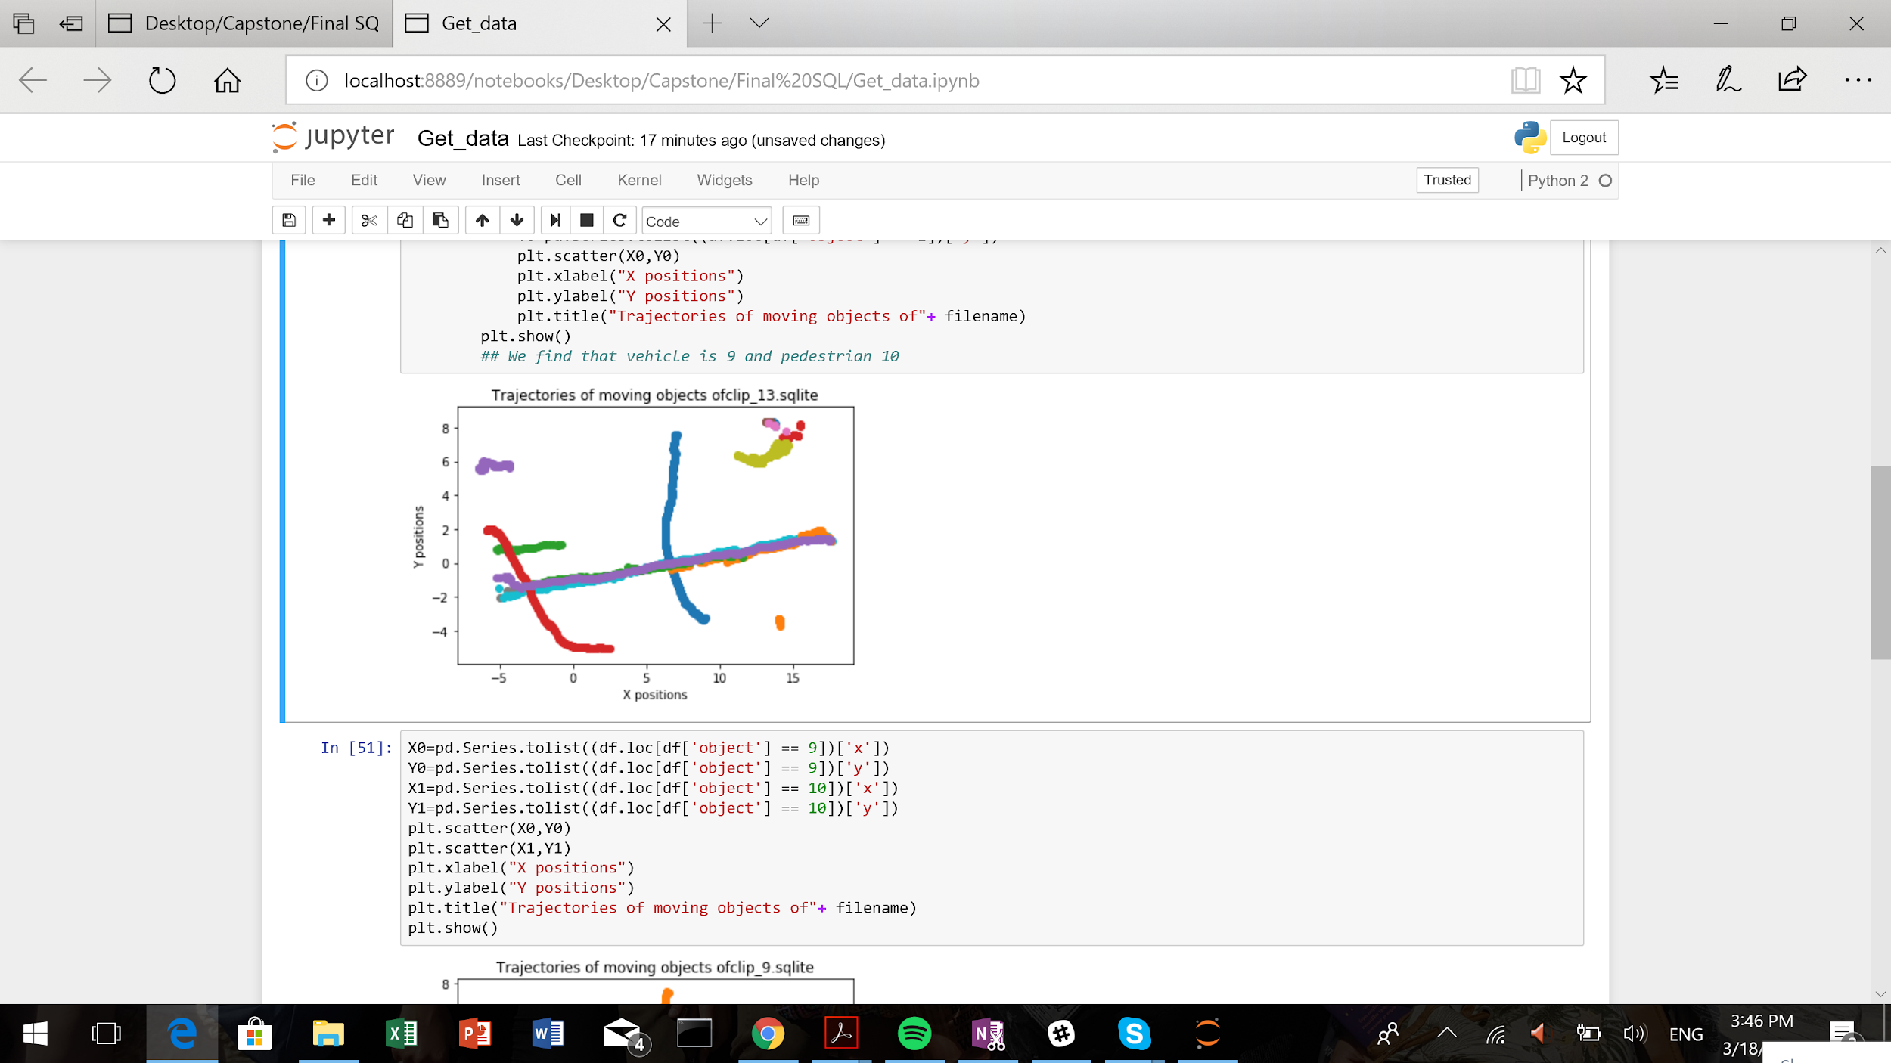
Grouping helps visualize the necessary results
All points
Averaged
Tracking
Grouping
Extracting

Slide 11
Complex ML algorithms are not needed for classification of objects on road
Hypothesis: An object whose Distance moved across Y direction > Threshold (say 10 metres) is a pedestrian
Notes:
Mubarak’s

Slide 12
Meaningful features are required for the model to work
Feature Engineering I
Inputs
Model
Output
Machine Learning
1
Relative Speed
2
Brake / No Brake
1
Research
Relative distance
4
3
Trajectories of pedestrians and vehicle
Menard, S. (2018). Applied logistic regression analysis (Vol. 106). SAGE publications.
Notes:
Salma - Define logistic regression

Slide 13
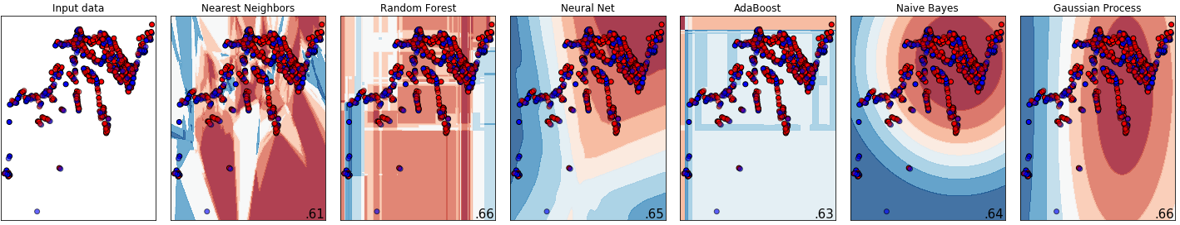
Comparison between different models
Figure: Relative speed along street plotted against relative distance along street
Notes:
Moyu

Slide 14
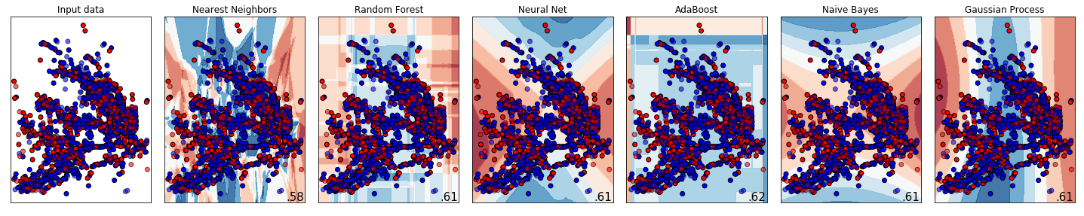
Comparison between different models
Figure: Relative speed along street plotted against relative distance along street
Notes:
Moyu

Slide 15
Meaningful features are required for the model to work
Feature Engineering II
Inputs
Model
Output
MAchine Learning model
1
Angle between Car & Pedestrian
2
Brake / No Brake
1
Research
Derivative of Angle
4
3
Relative Distance
Menard, S. (2018). Applied logistic regression analysis (Vol. 106). SAGE publications.
Notes:
Dan

Slide 16
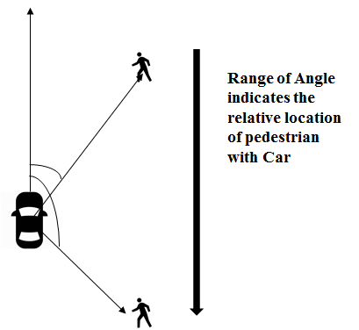
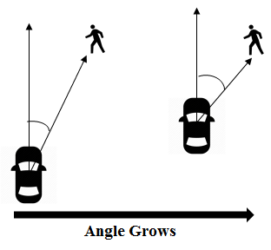
Feature Engineering Angle Between Car & Pedestrian
Menard, S. (2018). Applied logistic regression analysis (Vol. 106). SAGE publications.
Notes:
Dan

Slide 17
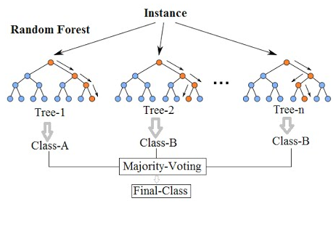
Weighted Random Forest Classifier can model the data better
1
Models non-linearity well
2
Interpretability is higher
3
Feature importance can be extracted easily

Slide 18
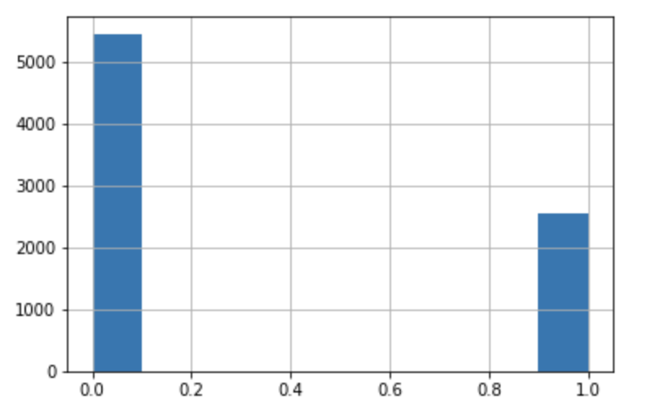
Imbalanced dataset can bias the model
1
8000 samples (interactions)
2
3 Feature engineered columns
No. of interactions
3
1 Response Variable (Brake/Not Brake)
Not Brake (0) / Brake (1)

Slide 19
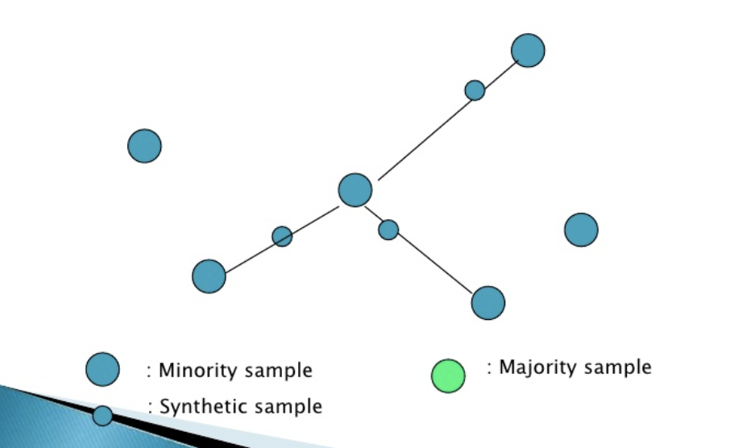
Oversampling the minority class can improve
balance
Synthetic Data Through KNN of Minority Class
1
0.75

Slide 20
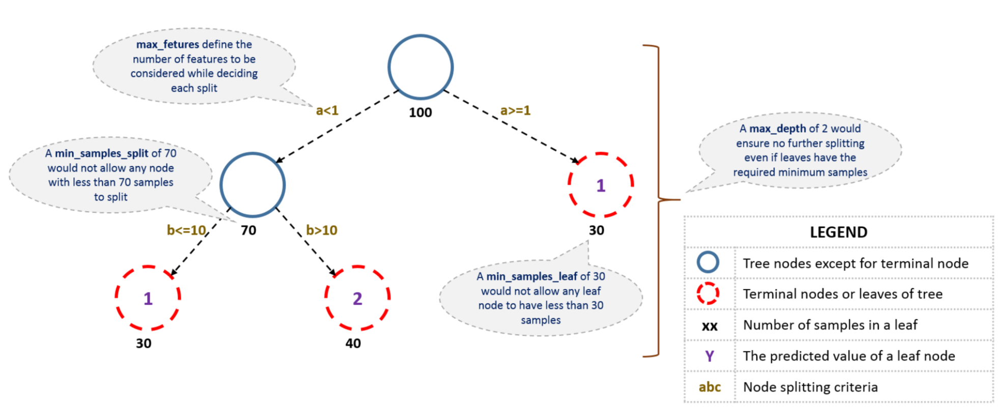
Tuning the algorithm is critical to model
performance

Slide 21
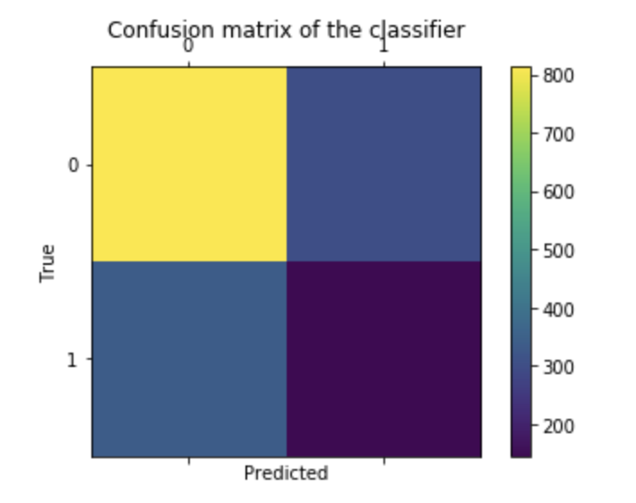
The model predicts one class better than
the other
0
F1 Score - 0.72
1
F1 Score - 0.31
3
F1 Score = 2 x (Precision x Recall) / Precision + recall

Slide 22
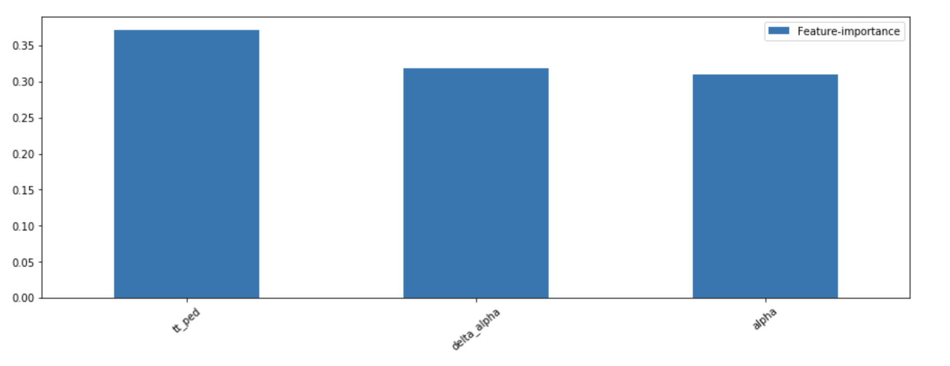
The time taken for the vehicle to reach the
pedestrian is most significant
3
Features

Slide 23
More data and feature engineering can
improve the model
1
Collect a more balanced dataset
2
Increase the size of the dataset
3
Building sanity checks into the feature engineering phase

Slide 24




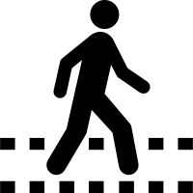
AV
IMPLEMENTATION
TRACKING
PATTERN IDENTIFICATION
REAL - TIME
INTERACTIONS
Notes:
Dan

Slide 25
References
Daniel J.Fagnanta, Kara Kockelmanb(2015). Preparing a nation for autonomous vehicles: opportunities, barriers and policy recommendations. Transportation Research Part A: Policy and Practice, 167-181
Saunier, N., and T. Sayed. A Feature-Based Tracking Algorithm for Vehicles in Intersections. Presented at Third Canadian Conference on Computer and Robot Vision, IEEE, Quebec City, Quebec, Canada, June 2006.
Saunier, N., T. Sayed, and C. Lim. Probabilistic Collision Prediction for Vision-Based Automated Road Safety Analysis. Presented at 10th International IEEE Conference on Intelligent Transportation Systems, Seattle, Wash., 2007.
Infoholic Research LLP. (2017). Autonomous Vehicle Market: Global Drivers, Restraints, Opportunities, Trends, and Forecasts to 2023. Research and Markets.
Glaser, Sébastien, et al. "Maneuver-based trajectory planning for highly autonomous vehicles on real road with traffic and driver interaction." IEEE Transactions on Intelligent Transportation Systems 11.3 (2010): 589-606.
Menard, S. (2018). Applied logistic regression analysis (Vol. 106). SAGE publications.
Lemeshow, S., & Hosmer Jr, D. W. (1982). A review of goodness of fit statistics for use in the development of logistic regression models. American journal of epidemiology, 115(1), 92-106.
Ismail, K. Application of Computer Vision Techniques for Automated Road Safety Analysis and Traffic Data Collection. PhD dissertation. University of British Columbia, Vancouver, Canada. 2010. http://hdl.handle.net/2429/29546.
Bradski, G., and A. Kaehler. Learning OpenCV: Computer Vision with the OpenCV Library.O’Reilly Media, Inc. 2008. http://oreilly.com/catalog/9780596516130/index.html.
Beymer, D., McLauchlan, P., Coifman, B., & Malik, J. (1997, June). A real-time computer vision system for measuring traffic parameters. In Computer Vision and Pattern Recognition, 1997. Proceedings., 1997 IEEE Computer Society Conference on (pp. 495-501). IEEE.
https://www.analyticsvidhya.com/blog/2016/04/complete-tutorial-tree-based-modeling-scratch-in-python/#nine

